Slide 1


Babak Emami,
Data Scientist Director / AI Architecture
Emami.Babak@gmail.com
647-326-6199

Slide 2
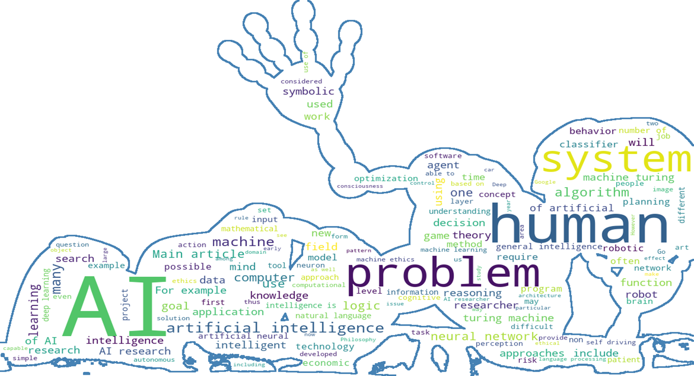
Automated AI-Based ETL Model (POC) documents QA

Slide 3
Agenda
Introduction: Why having an automated ETL process is required
Possible Solution: How to implement an AI-Based ETL pipeline
Implementation: Implementing a POC using Open-AI ( GPT 3.5 )
Future Works: How to improve the model efficiency

Slide 4

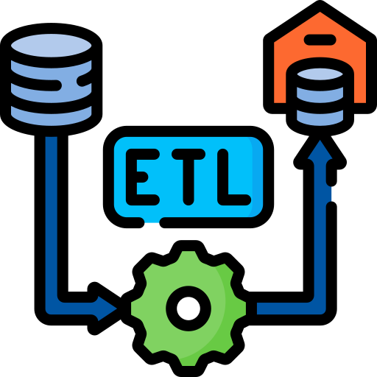

Introduction : Why having an automated ETL process is required
ETL stands for Extract, Transform, Load, which is a process used in data integration and data warehousing to move data from source systems to a target data store, such as a data warehouse.
AI-based Automated ETL:
Efficiency: by automating repetitive and rule-based tasks
Accuracy: minimize the possible human risk
Scalability: AI-based ETL tools can scale easily to handle large datasets
Real-time Processing: AI-based ETL can be easily adapt with Data drift and ensures that the data pipeline is always up to date

Slide 5
Possible Solution : How to implement an AI-Based ETL pipeline
Hybrid Machine Learning with Customized NER: Utilizes hybrid machine learning techniques by combining customized Named Entity Recognition (NER) for data extraction and transformation.
Columns and Data Type Forecasting using Deep Learning: Employs deep learning models to predict and classify columns and data types within the data, facilitating accurate transformations.
Data Lineage Connection using Network Graph: Creates a network graph representation of data lineage to track and visualize the flow of data, aiding in ETL process understanding.
Fine-tuning Local LLMs (e.g., T5, LLAMA, BERT, Roberta): Fine-tunes local language models on specific ETL tasks and data to improve their performance and relevance.
Using Pre-trained Models like GPT-3 or GPT-4: Incorporates pre-trained models like GPT-3 or GPT-4 to automate and enhance the ETL process with natural language understanding and generation capabilities.
Hybrid Model Combining GPT-3, Local LLM, and Document Classifier: Combines a hybrid model incorporating GPT-3 for context, local language models for task-specific understanding, and a document classifier to categorize data for efficient ETL operations.

Slide 6


Implementation: Implementing a POC using Open-AI ( GPT 3.5 ) GPT-3.5 can learn data drift in real-time and update ETL pipelines automatically.
The essence of our demonstration lies in harnessing the capabilities of GPT-3.5, an AI model known for its ability to adapt to real-time data changes, thereby automating the ETL process. We have successfully implemented a foundational AI-driven ETL solution to showcase the untapped potential of AI in streamlining ETL workflows.
Essential Requirements:
OpenAI API Token: This token serves as the key to connect with the OpenAI platform.
Python 3.8+: A prerequisite for running our AI-based ETL solution.
Flask: We have employed Flask to create a user-friendly dashboard and graphical user interface.
Pandas, Numpy: These data manipulation libraries are instrumental for parsing and analyzing datasets.
Engine and Cost Efficiency:
Within our project, we've chosen "text-davinci-003" as our GPT-3.5 model variant, which can effectively handle up to 4000 tokens. For our proof of concept, this variant is more than sufficient. Notably, the cost of utilizing this engine is approximately $0.002 per 1000 tokens, and this cost will be automatically computed and displayed during our live demonstration.
By embracing the versatility and cost-effectiveness of GPT-3.5, we underscore the immense possibilities of automating the ETL process with AI.

Slide 7

Live Demo.

Slide 8
Future Works: How to improve the model efficiency
While relying on GPT-3.5 can yield impressive results, it may not always be the most cost-effective choice. As demonstrated, analyzing 10 records costs us approximately $0.003. While this is a negligible cost for small-scale projects, it becomes a significant factor when dealing with the analysis of millions of records per day in large-scale ETL processes.
In this proof of concept (POC), we have harnessed the capabilities of GPT-3.5 to demonstrate its potential. However, for practical implementation, we are adopting a hybrid approach. GPT-3 will serve as the engine for analyzing sample records while we enhance our local ETL functions to efficiently clean and reformat the entire dataset.
In the future, we are actively developing a novel ETL pipeline that can intelligently extract relevant data, make modifications to the dataset, and analyze sample data using this advanced model. For the remaining data, offline manipulation will be the strategy of choice.
A condensed version of this project has been prototyped and presented in Code_Generatore_2023_10_11_v0.2.ipynb

Slide 9
Summary
In summary, AI-based Automated ETL is crucial for enhancing the efficiency, accuracy, and adaptability of data integration and transformation, catering to the evolving needs of data-driven businesses.
This technology empowers organizations to harness their data assets for more effective analytics, reporting, and decision-making.
Relying solely on Large Language Models (LLMs) without the integration of a Local Machine Learning model can be both costly and risky.

Slide 10

Thank you!

